Slide 1

Messaging Maarten Smeets Software architect

Slide 2




Who is Maarten?
Biology 1999 – 2006
De Jong Assurantiën (2000 – 2006)
Ordina (2006 – 2009)
Atos (2009 – 2014)
AMIS (2014 – nu)

Slide 3










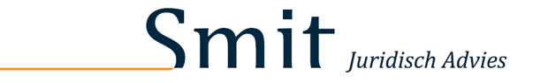



Who is Maarten? Customers

Slide 4




Who is Maarten?
Worked at AMIS since 2014
Several certifications
SOA, BPM, MCS, Java, SQL, PL/SQL, Mule, AWS, Scrum, Software architecture
Enthusiastic blogger (150+ blogs) http://javaoraclesoa.blogspot.com https://medium.com/@MaartenSmeetsNL https://technology.amis.nl/author/maarten-smeets/
https://nl.linkedin.com/in/smeetsm
@MaartenSmeetsNL

Slide 5
Agenda
Morning
When | What
8:30 | Walk-in
9:00 | Presentation Messaging Introduction
9:45 | Coffee break
10:00 | Presentation Introduction Kafka and workshop
10:45 | Start workshop
12:00 | Lunch

Slide 6
Agenda
Afternoon
When | What
12:00 | Lunch
12:45 | Presentation Kafka clients
13:30 | Workshop Kafka clients
14:15 | Coffee break
14:30 | Presentation Schema Registry
15:15 | Workshop Schema Registry
16:45 | Done

Slide 7


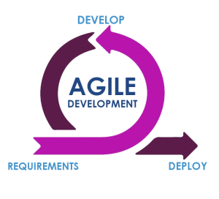


B2B partners
Enterprise Integration
web
mobile
User Interface
SaaS, PaaS & IaaS
SOAP Web Service
REST API
12
NodeJS application
Linux
Container
14
REST API
IoT Hub
8
REST API
Software Engineering
11
SOAP Web Service
9
Client
6
7
NodeJS application
NodeJS application
NodeJS application
Source Code control
5
Build, QA, Test & Deploy
2
Data Modellering
Linux
Linux
Linux
Container
Container
Container
Issue Management
10
Kubernetes
Wiki
Database
SQL
Message & Event Bus
3
13
NoSQL
4
Linux
Virtual Machine
10

Slide 8
Introduction messaging
Introduction messaging

Slide 9
An (electronic) message is specially formatted data describing events, requests, and replies

Slide 10
Formatted data
Comes in many flavors
Enterprises often require features of the format / data used
Standardized (by official companies maintaining those standards, e.g. W3C) and proven (a history of successful implementations)
Must have a definition (so the message can be checked for validity)
Easily interpretable (by humans and machines). E.g. enables code generation
Efficient in transit
Secure

Slide 11
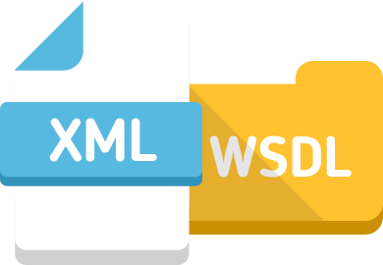

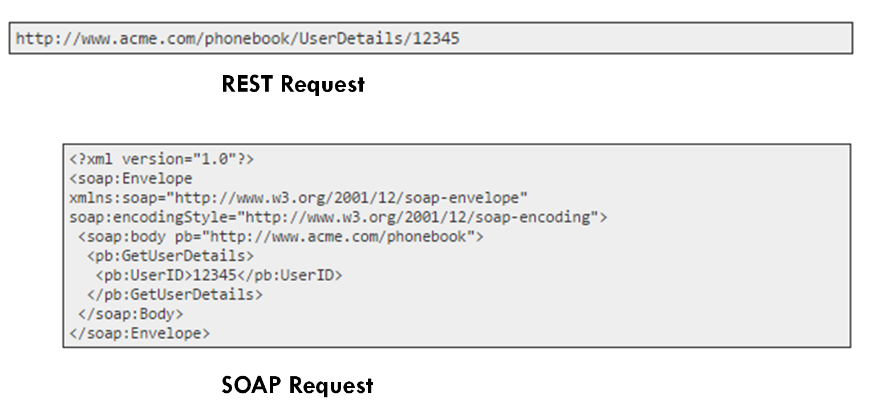






Formatted data
SOAP
REST
What described the data format? (language, notation)
What defines the data structure?
Which are data content conventions?
Notes:
Not so easy
What is the message

Slide 12
Formatted data
SOAP
REST
Data format (e.g. XML, JSON)
Data definition (e.g. XSD, OpenAPI)
Data content conventions (e.g. WS-Security, JOSE)
Notes:
Not so easy
What is the message

Slide 13
Messaging is the creation, storage, exchange, and management of messages over a communications network.

Slide 14

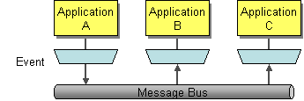
Messaging An Enterprise Integration Pattern
How can I integrate multiple applications so that they work together and can exchange information?
https://www.enterpriseintegrationpatterns.com/patterns/messaging/Messaging.html

Slide 15
Message exchange patterns
Request-reply
Publish-subscribe
Client
Requestor
Request
Service
Replier
Reply
Client
Client
Broker
Consume
Produce
Consume
Client
Consume
Client
Publish
Subscribe

Slide 16
Message exchange patterns Synchronous
Synchronous: provides an immediate response to a query. The client will wait until the server sends back the response message
Benefits: the client has an immediate answer
Challenges
Front-end experience; the client has to wait
Performance. The called server needs to respond in time (timeout settings) since a connection is kept open

Slide 17
Message exchange patterns Synchronous. Some considerations
Don’t use if you expect the reply to possibly take longer than 1 minute (a regularly used timeout)
Use only for services which provide quick responses (a couple of seconds max)
Use for services of which you need an immediate reply for further processing
Don’t have a single front-end screen (client) call many synchronous services one after each other
Think about service layering. More layers is more communication overhead, timeout challenges. Suggestion: Data (highly reusable, do not change much), Domain, Presentation (very specific, change often) https://martinfowler.com/bliki/PresentationDomainDataLayering.html
Don’t use for document processing and calls to systems which have concurrency issues
What happens when retries take place? (avoid hammering when the backend is still busy processing)

Slide 18
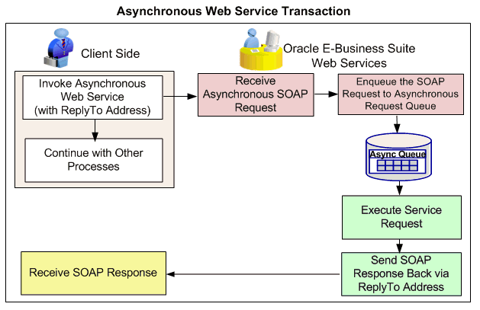
Message exchange patterns Asynchronous
Asynchronous: Client sends a request and can continue processing. The request will be processed without the client having to wait for it. A callback is optional. The response is send back in a separate request to the caller (which needs to be listening) The callback request can be a webservice call or an event Alternative to callback:
polling from a client. This is a poor practice.

Slide 19



Message exchange patterns Asynchronous
Benefits
The client does not have to wait
Client is not dependent on back-end processing time
Challenges
How will the client be informed once processing is complete?
How do you keep track of submitted requests and their status in general?
How do you avoid issues on backend systems once the frontend sends many processing request
Many customers have poor experiences with long running processes waiting for callbacks. Suppose you’re not waiting on the callback anymore can you receive multiple callbacks?

Slide 20


Message exchange patterns Request-reply
Benefits
Requestor often gets an immediate answer (synchronous) Fire-and-forget is possible (asynchronous) and callback also.
No broker is required. Requestor communicates directly with replier
Drawbacks
Tight coupling
The requestor might need changes if the replier changes
The requestor needs to know who the replier is
How to deal with a broadcast scenario’s?

Slide 21


Message exchange patterns Publish-subscribe
Benefits
Loose coupling (often asynchronous)
The producer does not need to know the consumers
Consumers can be added and removed without impact to the producer
A single message can be consumed by multiple consumers (broadcast)
Drawbacks
The producer does not receive replies (no feedback)
The producer does not know if and which consumers have picked up the message
A broker is required to publish to and subscribe at

Slide 22
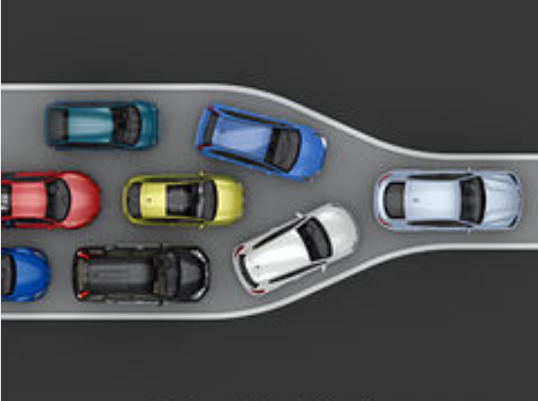
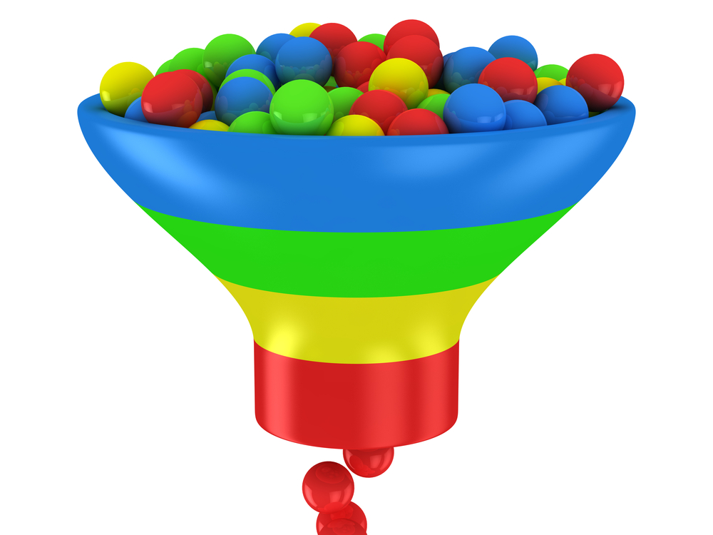
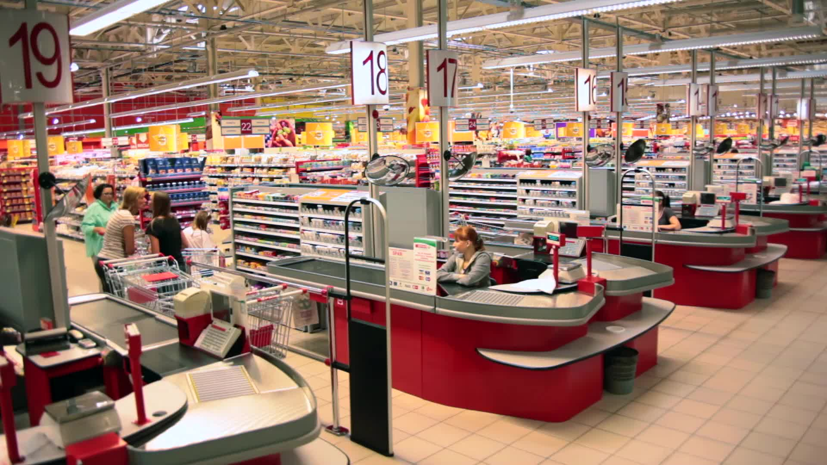
Message exchange patterns Publish-subscribe
Throttling Debatching. Spread processing over a longer period
Concurrency Suppose a system can only handle x much simultaneous requests

Slide 23
Message exchange patterns Publish-subscribe
Push
Pull
I’ve got a new message for you
The broker takes action to inform the consumer
Broker takes responsibility of keeping track of consumers
Broker
Consumer
The consumer takes action by requesting the broker regularly for new messages
Consumer is responsible for fetching messages
Never do this with many web clients!
Have you got new messages?
Have you got new messages?
Have you got new messages?
Broker
Consumer
Have you got new messages?

Slide 24
Quiz Request-reply or publish-subscribe Synchronous or asynchronous
Posting a Twitter message
Requesting a loan
Buying a vegetables at the supermarket
Buying a new laptop online
Giving a presentation

Slide 25
Quiz Request-reply or publish-subscribe Synchronous or asynchronous
Posting a Twitter message Asynchronous publish-subscribe
Requesting a loan Asynchronous, request-reply
Buying a vegetables at the supermarket Synchronous, request-reply
Buying a new laptop online Asynchronous, request-reply
Giving a presentation Synchronous, publish-subscribe

Slide 26
Quiz: IT usecases Request-reply or publish-subscribe Synchronous or asynchronous
Uploading a document
Converting and storing a document
Visiting a website
Processing sensor data (IoT)
Displaying real-time data in dashboards

Slide 27
Quiz: IT usecases Request-reply or publish-subscribe Synchronous or asynchronous
Uploading a document Synchronous, request/reply
Converting and storing a document Asynchronous, publish-subscribe
Visiting a website Synchronous, request/reply
Processing sensor data (IoT) Asynchronous, publish-subscribe
Displaying real-time data in dashboards Asynchronous, publish-subscribe

Slide 28


Message exchange patterns
Request-reply Webservices
Publish-subscribe Queues and topics
Queue
Topic

Slide 29
Message exchange patterns Publish subscribe
A
Consumer 1
A
B
C
A
B
C
B
Consumer 2
Producer
Queue
C
Consumer 3
A
B
C
Consumer 1
A
B
C
A
B
C
A
B
C
Consumer 2
Producer
Topic
A
B
Consumer 3
29

Slide 30
Quiz Queue or topic
Documents need to be processed (converted and stored) asynchronously by a backend system
New employee information needs to be added to several systems
Several clients are connected to an online chatroom and are posting messages
You want to implement guaranteed delivery of messages to the backend
You want to manage the load on backend systems by throttling requests

Slide 31
Quiz Queue or topic
Documents need to be processed (converted and stored) Queue asynchronously by a backend system
New employee information needs to be added Topic to several systems
Several clients are connected to an online Topic chatroom and are posting messages
You want to implement guaranteed delivery Queue of messages to the backend
You want to manage the load on backend Queue systems by throttling requests

Slide 32

Kafka
Introduction

Slide 33
What are the drivers of change?
The volume and speed of data is increasing rapidly (IoT, Big Data)
Consumer push for fast sites / apps and up to date real-time information
Business push towards more focus on providing business value quickly
‘traditional solutions’ are not a fit anymore to the demands and expectations of modern times

Slide 34
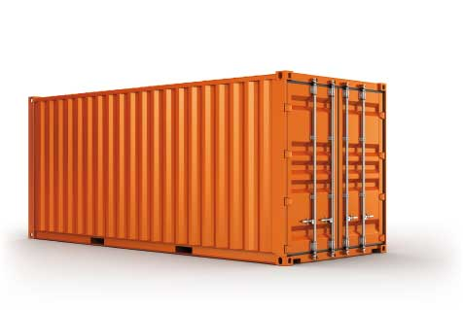


Messaging Trends in the IT world
Specialization No more big application server or platform which does everything but small loosely coupled components. Not ‘one size fits all’
Virtualization and containers Simplified environment provisioning Get up and running quickly in an isolated environment.
Move to open source Even by large software vendors like Microsoft, IBM, Oracle
Webscale / Cloud New products are build from the ground up to be scalable and handle load quickly
42

Slide 35
Apache Kafka
Apache Kafka First release 2011 An open-source stream-processing software platform which aims to provide a unified, high-throughput, low-latency platform for handling real-time data feeds.

Slide 36
How it used to be Publish-subscribe / Queueing
Java Messaging System, JMS
Topics
Queues
Challenges when the consumer is offline
By default with a topic the message is gone
Workaround: durable subscribers
Message buildup and monitoring
Challenges with scalability
Difficult to efficiently scale up/down
Cannot process a lot of messages quickly
Not flexible
Queues / topic usually have types defined.
Messages have predefined headers

Slide 37
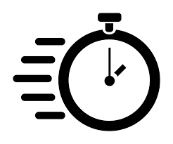



Why Kafka
Fast
Easy to use
Scalable
Loose coupling

Slide 38
Kafka What is it used for
Messaging
Twitter, Uber, LinkedIn
Website Activity Tracking
Mouse flow, click path
Metrics
IoT, Kafka
Log Aggregation
Collect and process log data from different sources
Stream Processing
Query continuous data streams, e.g. anomaly detection
Event Sourcing
Store all changes to application state as a sequence of events
Commit Log
A commit log is a record of transactions
Notes:
Commit log is

Slide 39









Kafka Who uses it?
https://cwiki.apache.org/confluence/display/KAFKA/Powered+By

Slide 40








Kafka Who uses it in the Netherlands?

Slide 41
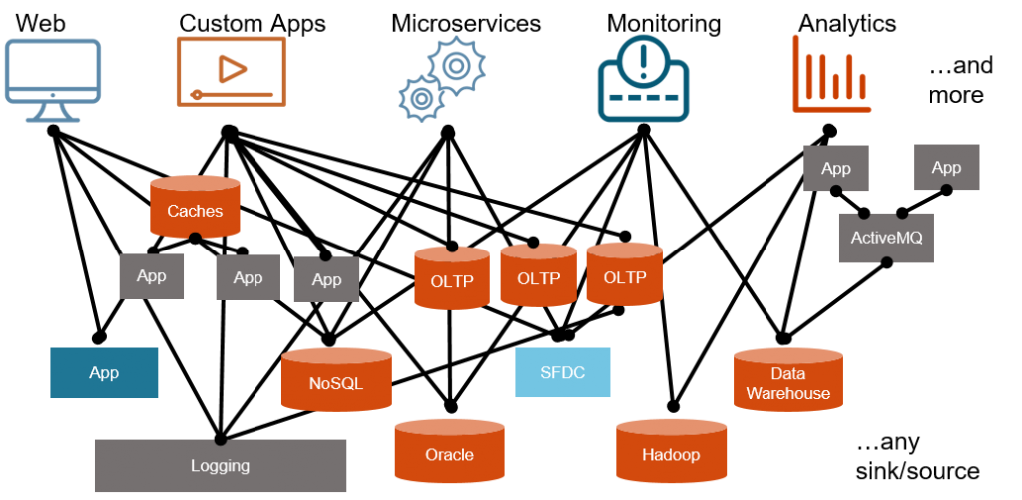
Kafka The marketing slides

Slide 42
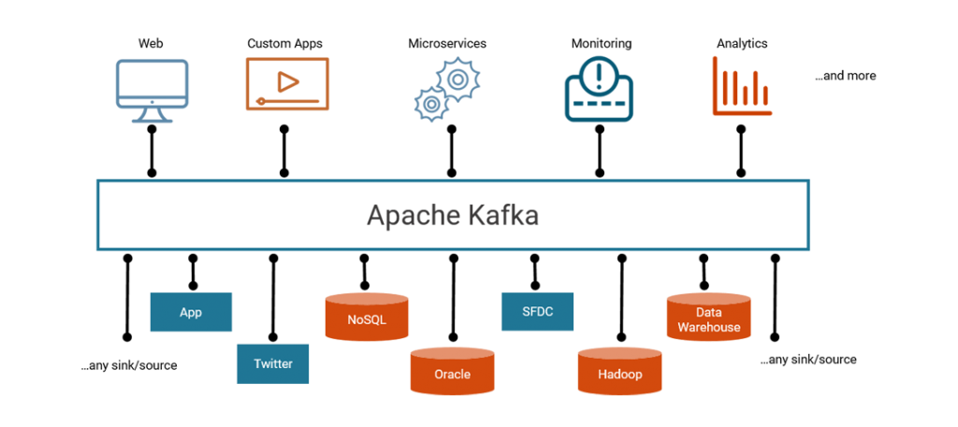
Kafka The marketing slides

Slide 43
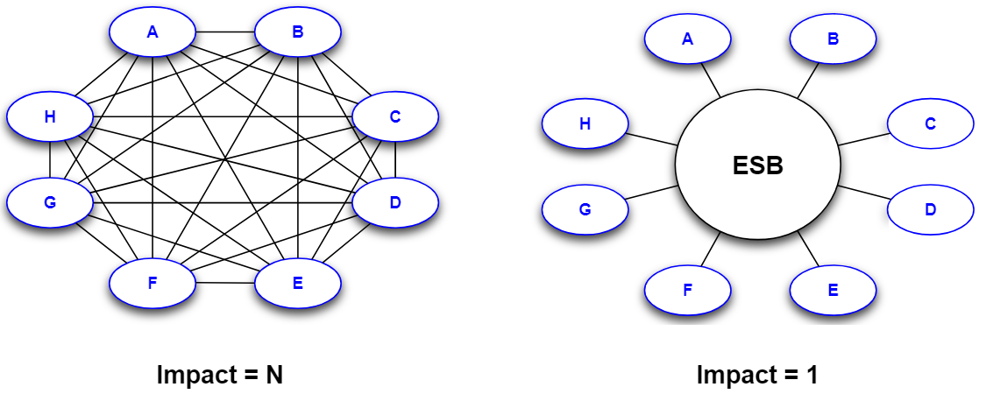
Kafka However
If everything is connected to Kafka, it becomes a single point of failure. Kafka is usually configured to be highly available, but still…
The positioning of Kafka is a central component where everyone publishes to and consumes from. It however
It is asynchronous.
Publish now, process later
Mostly suitable for backend or front-end fire & forget
This is the same story as with the Service Bus in the past

Slide 44
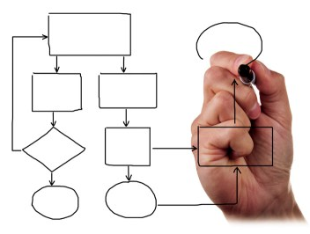




Kafka Challenges with a central component
Data modelling. Producers and consumers need to speak the same language Kafka accepts any message (unless you use Avro with the Schema registry)
Interfacing with different systems. Kafka is passive and does not reach out. (Kafka connect can act as producer/consumer)

Slide 45
Kafka terminology

Slide 46


Kafka Terminology
Producer
Consumer
Broker
Topic
Message
Zookeeper
Zookeeper
Message
Broker
Producer
Topic
Consumer

Slide 47
Kafka Terminology
Producer
Consumer
Broker
Topic
Message
Zookeeper
6
5
3
1
4
2

Slide 48



Kafka terminology Zookeeper
Check availability of brokers
Store consumer offsets
Determine the leader for each topic

Slide 49
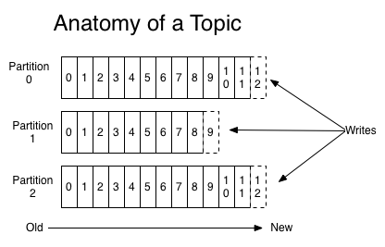
Kafka terminology Topic and partitions
a message at an offset
a producer

Slide 50
Kafka terminology Topic and partitions
1
a 2 at a 3
5
a 4
5
5

Slide 51
Kafka terminology Topic and partitions
Topic
Message
Offset
Producer
Partition
1
a 2 at a 3
5
a 4
5
5

Slide 52
Kafka terminology Quiz
What does Kafka implement in terms of messaging
Queues and / or topics?
Request reply or publish / subscribe?
Synchronous or asynchronous interaction between producer and consumer?
Does Kafka push messages or do consumers pull?
Do producers push messages or does Kafka pull?
Where would you solve throttling and concurrency challenges; Kafka, Producer or consumer?

Slide 53
Kafka terminology Quiz
What does Kafka implement in terms of messaging
Queues and / or topics? Topics
Request reply or publish / subscribe? Publish / subscribe
Synchronous or asynchronous interaction between producer and consumer? Asynchronous
Does Kafka push messages or do consumers pull? Pull
Do producers push messages or does Kafka pull? Push
Where would you solve throttling and concurrency challenges; Consumer Kafka, Producer or Consumer?

Slide 54
Kafka
Workshop 1

Slide 55





Introducing the workshop Tools

Slide 56
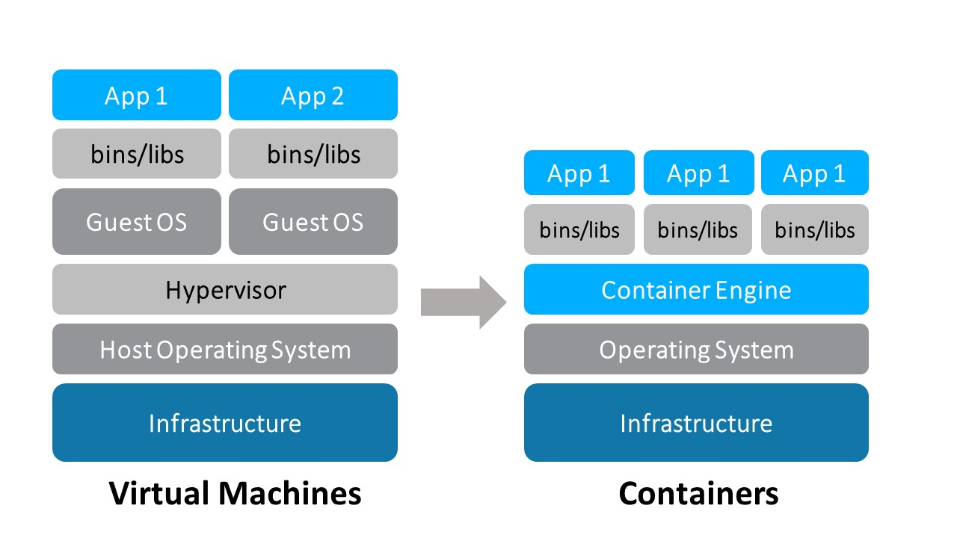

Introducing the workshop Virtual machines and containers

Slide 57




Introducing the workshop Why Docker
With a single command
Isolated
Automated ‘installation’
Resource efficient

Slide 58
Introducing the workshop Environment
Host OS
Virtualbox
Ubuntu
Docker
Kafkatool
Node.js
Kafka broker
Zookeeper
Kafka connect
Kafka schema registry
Kafka REST proxy
Kafka Streams, KSQL
PostgresDB

Slide 59
Introducing the workshop Environment
Host OS
Virtualbox
Ubuntu
Docker
Kafkatool
Node.js
Kafka broker
Zookeeper
Kafka connect
Kafka schema registry
Kafka REST proxy
Kafka Streams, KSQL
PostgresDB

Slide 60
Introducing the workshop The docker containers
Docker compose. A composition of containers. Start them with docker-compose up –d This downloads the images and runs them in the background
2 containers relevant for this workshop
kafkaworkshop_zookeeper_1
kafkaworkshop_kafka1_1

Slide 61
Introducing the workshop Help! I screwed up!
docker-compose stop Stops all containers
docker-compose rm Removes stopped containers
docker-compose up –d Creates new containers from the images

Slide 62
Introducing the workshop Console commands
kafka-topics
Create topics, delete topics, describe topics, …
kafka-console-producer
Produce messages from the console
kafka-console-consumer
Consume messages from the console

Slide 63
Workshop 1
Download workshop and presentation from: https://github.com/MaartenSmeets/talentlaunch
Getting started with the VM
Getting started with Kafka

Slide 64


Kafka clients
Node
Postman +
REST proxy

Slide 65
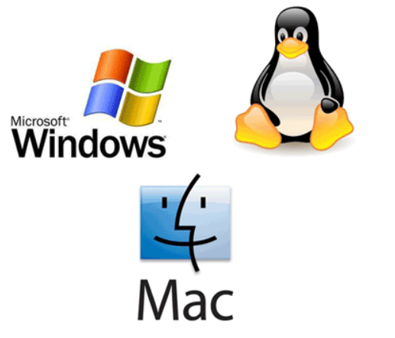
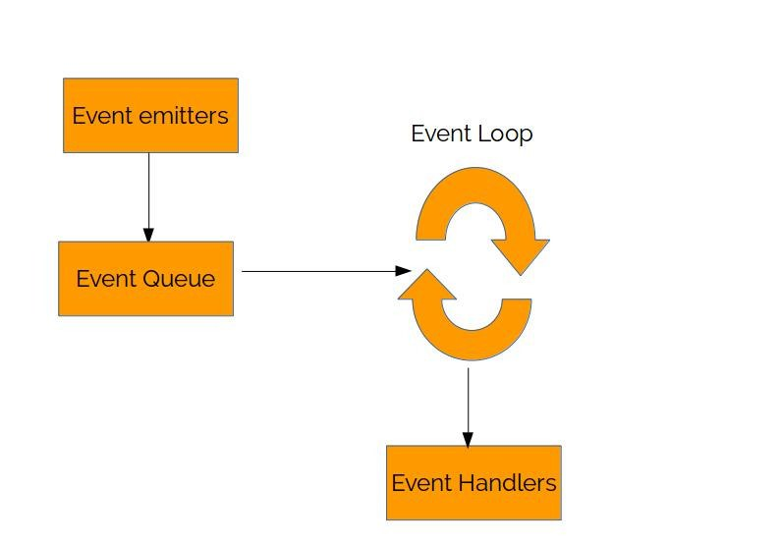
Introducing Node.JS
Cross platform
Event driven Asynchronous
JavaScript runtime Compare to a JVM
Extremely fast Based on Google’s V8 engine

Slide 66
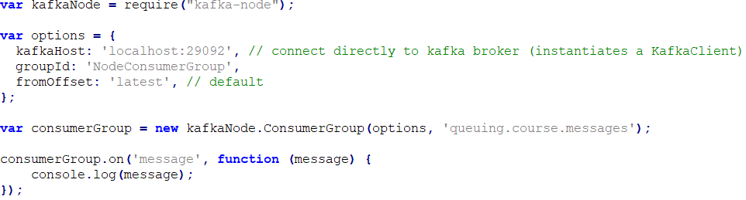
Node as Kafka consumer

Slide 67
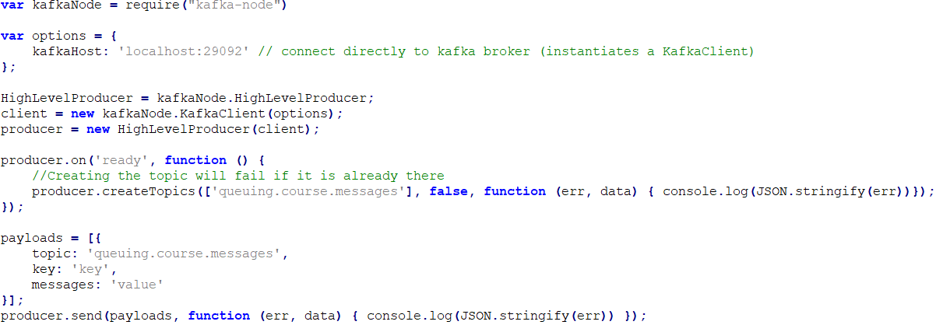
Node as Kafka producer

Slide 68
Workshop 2.1
Create a Node Kafka consumer
Create a Node Kafka producer
Create a Node application which
Consumes data
Transforms the data
Produces the transformed data to a new topic

Slide 69
Workshop 2.2
Use Postman with the REST gateway
Produce messages
Consume messages

Slide 70
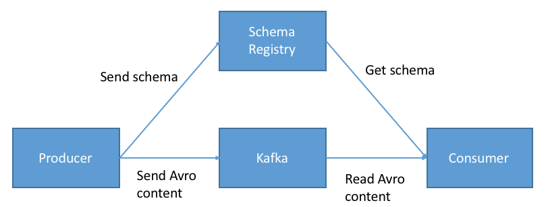
Kafka Schema Registry

Slide 71


Kafka Why do we need a schema?
Kafka stores data in binary format
Kafka does not check message contents
If producers publish different messages, consumers might break
Changes in messages can be
backwards compatible or non-breaking
Not backwards compatible or breaking

Slide 72
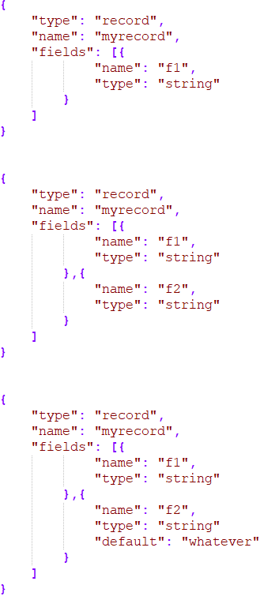
Kafka Why do we need a schema
Starting JSON Schema definition
Not backwards compatible change
Backwards compatible change

Slide 73
Kafka message format Why not JSON?
JSON is inefficient in transport. A text format and no binary
JSON is weakly typed. Only number, string, array, boolean, object What about durations, timestamps, limited length strings, different number types?
When a JSON message is received, the receiver does not know how to interpret the JSON. Data definition is not part of the message
Checking for breaking changes to the definition is hard. Where is the definition?

Slide 74
Apache Avro
Apache Avro™ is a data serialization system A message exchange format
Avro stores data together with its schema
Avro uses a JSON schema format
An Avro message is a compact binary

Slide 75
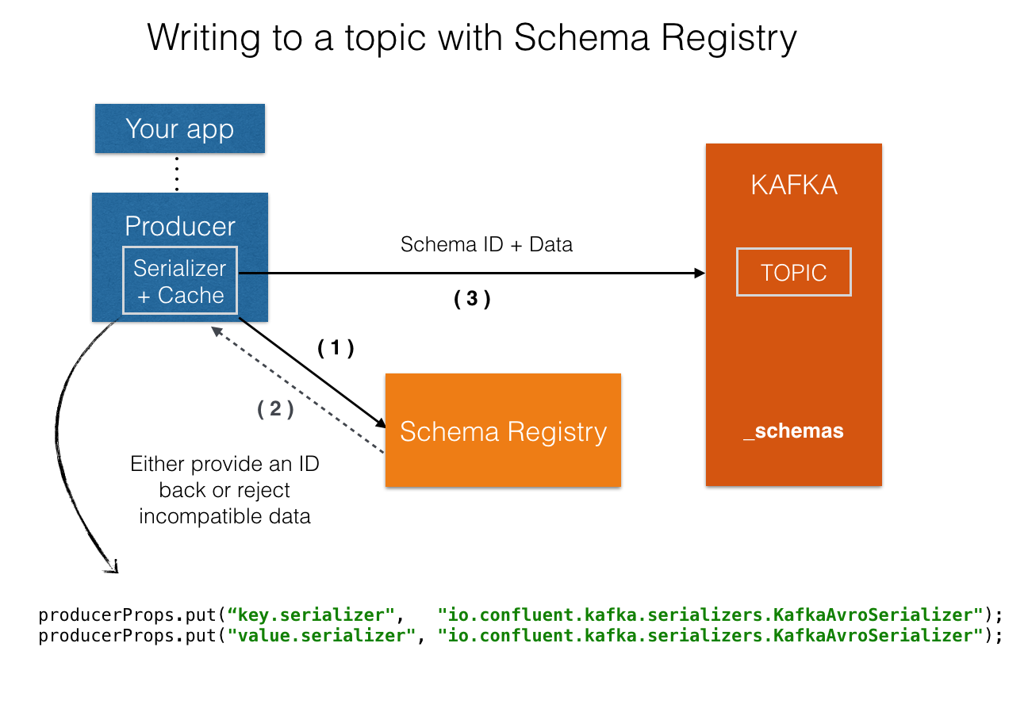
Schema registry

Slide 76
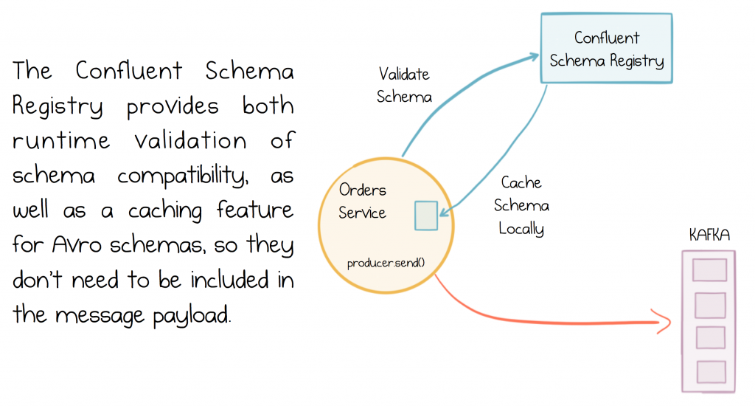
Schema registry

Slide 77
Workshop 3 Kafka Schema Registry
Produce Avro messages using a specific schema
Consume Avro messages
Produce messages using a different schema
Create a backwards compatible schema
https://docs.confluent.io/current/avro.html#backward-compatibility
Notes:
Based on: https://docs.confluent.io/3.0.0/quickstart.html

Slide 78
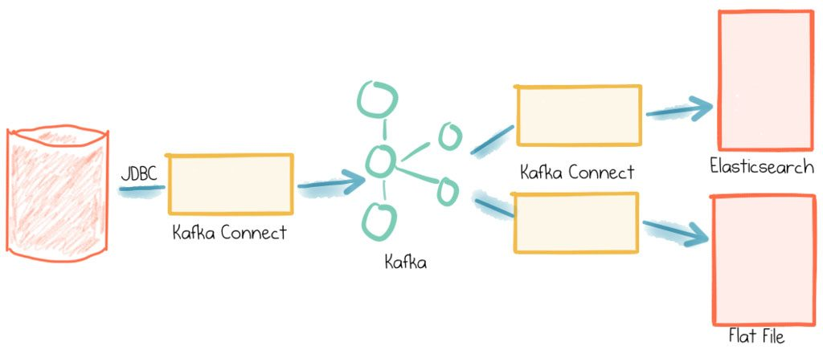
Kafka Connect

Slide 79
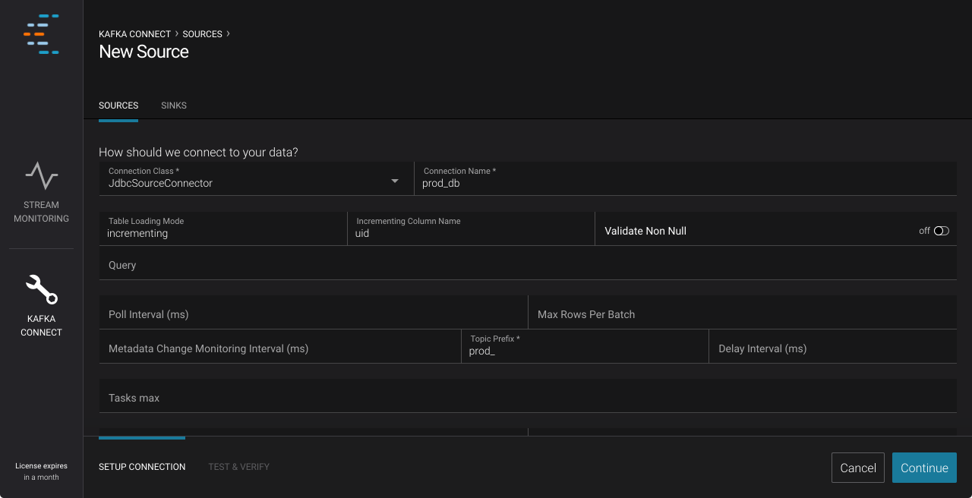
Kafka Connect
Many connectors are available to allow integration with diverse systems https://www.confluent.io/hub/
Can be monitored from Control Center (commercial product!) https://www.confluent.io/blog/monitoring-apache-kafka-confluent-control-center-video-tutorials/

Slide 80
Kafka connect Workshop 4
Instantiate a Kafka Connector to monitor a Postgres database
Insert data in the database and see it being picked up by the connector

Slide 81
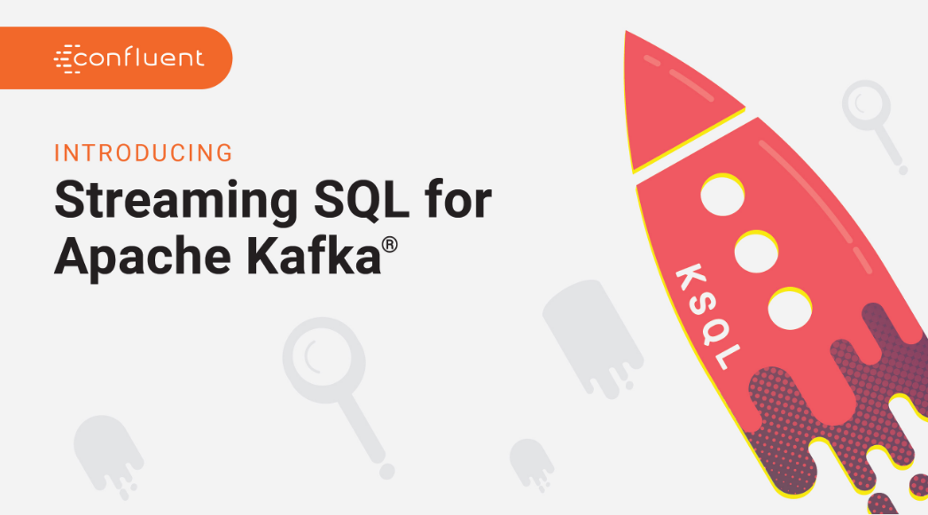
Kafka Streams and KSQL

Slide 82
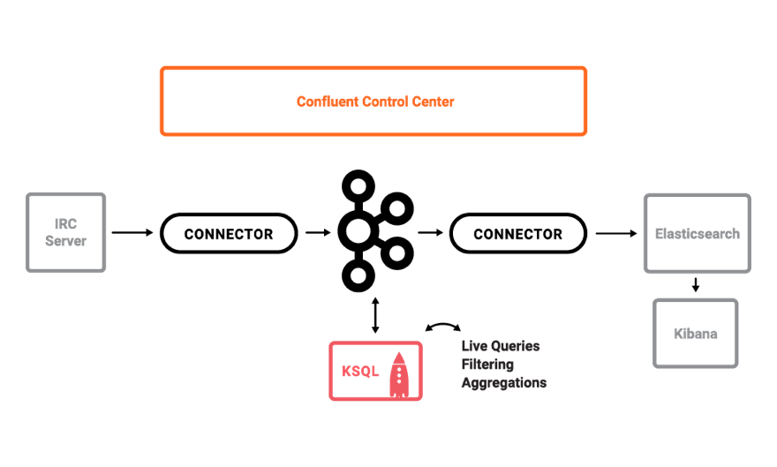
KSQL: Build on top of Kafka Streams

Slide 83
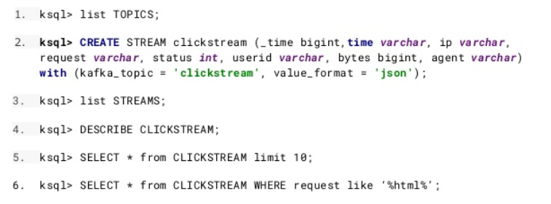
KSQL

Slide 84
KSQL Workshop 5
Create a stream and a table
Write queries
Join streams and tables
Merge streams

Slide 85
Thank you for your attention Maarten Smeets +31 (0)6 30959564 Maarten.Smeets@Amis.nl

